Slide 1
LTO WIIN Act Meeting
December 2024

Slide 2
Agenda
Overview of Longfin Smelt Critical Habitat (USFWS)
Summary of Current NEPA/ESA Progress
Record of Decision
Biological Opinions
Remaining Schedule and Requirements
Trinity River Division

Slide 3
Prior WIIN Act Quarterly Meetings (1 of 3)
March 2022 – Scoping Meetings
June 2022 – Initial Alternatives
September 2022 – Seasonal Operation Deconstruction and Initial Alternatives
December 2022 – Lines of Evidence
March 2023 – Environmental Impact Statement (Affected Environment)

Slide 4
Prior WIIN Act Quarterly Meetings (2 of 3)
June 2023 – Environmental Impact Statement (Alternative Components)
September 2023 – Modeling Updates, EIS, BA comment themes
December 2023 – Biological Modeling and Biological Assessment

Slide 5
Prior WIIN Act Quarterly Meetings (3 of 3)
March 2024 – Cooperating Agency 2nd Draft EIS release
June 2024 – Cooperating Agency Comment Themes, Release of DEIS
September 2024 – Themes of Public Comments Received on DEIS

Slide 6
Longfin Smelt Critical Habitat
Information provided by USFWS

Slide 7
2021 NEPA and ESA Process (1 of 2)
NEPA
Notice of Intent, Scoping, No Action review, and Resource Analyses
Initial Alt Report
Co-op Draft Environmental Impact Statement, Summary, Purpose and Need, Proposed Alternatives, Resource Areas
Public Draft Environmental Impact Statement, Action Alternatives, Preferred/Proposed Action, Analysis
Final Environmental Impact Statement
Record of Decision

Slide 8
2021 NEPA and ESA Process (2 of 2)
ESA
Draft Biological Assessment
Final Biological Assessment
Biological Opinions

Slide 9
Public Review
July 26, 2024 – Release of Public Draft EIS
August and September 2024 – 3 in-person meetings and 3 virtual meetings
September 9, 2024 – End of public comment period; received 1,100 comment blocks for response
November 15, 2024 – Release of Final EIS and start of 30-day cooling off period

Slide 10
Record of Decision
Identifies the Environmentally Preferrable Alternative
Identifies the Selected Alternative

Slide 11
ROD Key Considerations
Key Considerations cover a range of factors
Listed species protections
Water service and repayment contracts
Power generation
SWP operating criteria in the Delta
Collaborative Adaptive Management
Winter-Run Action Plan
Healthy River and Landscapes Program
Climate Change
Fall-run Chinook salmon
Environmental Justice

Slide 12
ROD Mitigation Measures (1 of 2)
MM BIO-4: Real-time Group Considerations for Bank Swallow
MM EJ-1: Increasing Participation with Tribal, Minority, and Low-Income Populations
MM EJ-2: Reduce Effects of Employment Loss
MM EJ-3: Increasing Participation with Trinity River Parties
MM WS-1: Coordination with Byron Bethany Irrigation District

Slide 13
ROD Mitigation Measures (2 of 2)
MM WS-2: Coordination with Contra Costa Water District
MM AQUA-2: Delta Smelt Monitoring
MM AQUA-3: Longfin Smelt Monitoring
MM AQUA-4: Fall-run Chinook Salmon Brood Year Assessment

Slide 14
ROD Permitting and Compliance (1 of 2)
Considered the following regulatory processes in preparation of the EIS:
Clean Water Act
Endangered Species Act
Executive Order 13990
Executive Order 12898

Slide 15
ROD Permitting and Compliance (2 of 2)
Considered the following regulatory processes in preparation of the EIS:
Indian Trust Assets
Magnuson-Stevens Fishery Conservation and Management Act
National Historic Preservation Act
Water Infrastructure Improvement for the Nation Act

Slide 16
2024 USFWS Biological Opinion
Incidental take of Delta smelth and longfin smelt from entrainment
Incidental take of giant garter snake from voluntary idling/fallowing
Incidental take of western pond turtle from covered operations and maintenance activities
Becomes effective if listed

Slide 17
Differences between 2019 and 2024
Adaptvie Management Program
Shasta Reservoir Framework
Winter-Run Chinook Salmon Action Plan
Shasta Operations Team
Programmatic approach for monitoring
Spring Delta Outflow/Healthy River and Landscapes Program
Longfin smelt Old and Middle River measures
Updates for Delta smelt supplementation

Slide 18
Adaptive Management Program
Adaptive Management Steering Committee, Adaptive Management Teams
Adaptive Management Pathway (aka “Bins”) depending on duration
Three Phases:
1) Plan, 2) Do, 3) Evaluate and Respond
USFWS RPM – 90-day technical assistance period to confirm if within the effects analyzed or triggers reinitiation

Slide 19
Adaptive Management Framework

Slide 20
Adaptive Management Framework

Slide 21
Healthy Rivers and Landscape (HRL) Program
ROD does not include SWP HRL actions
USFWS Biological Opinion
Includes the federal and state HRL actions
CVP proposed early implementation of “foregone exports”
SWP proposed obth early and post implementation, including:
Increase in upstream land fallowing
Reduced exports

Slide 22
Final EIS Milestones
Final NMFS Biological Opinion – December 11, 2024
Cooling off period concludes – December 16, 2024
Record of Decision executed – December 20, 2024

Slide 23
Trinity River Division (TRD) Reconsultation Update
Topics
Joint Lead Meetings
Screening Criteria
Draft TRD alternatives
Preliminary CalSim modeling results
Discussion on water temperature modeling
Upcoming coordination and schedule

Slide 24
Trinity River Division (TRD) – Joint Lead Meetings
Eight Joint Lead Technical meetings in 2024
Topics of discussion include
Relation to Central Valley/NEPA document options
Range of draft NEPA alternatives and screening criteria
Development of Biological Assessment
Approach for analyzing effects to salmonids
Approach for analyzing water temperatures for alternatives
Preliminary CalSim modeling results

Slide 25
Trinity River Division (TRD) – Screening Criteria
Purpose and Need
Technologically and Economically Feasible
Value Added
Completeness
Preferred Alternative Selection Criteria

Slide 26
TRD Preliminary Alternatives (1 of 2)
No Action Alternative – 2000 ROD, 2017 ROD, 2020 ROD
Alternative 1 – Water Quality Control Plan
Alternative 2 – Multi Agency Deliberation
Alternative 3 – Modified Natural Hydrograph
Alternative 4 – Risk-Informed Operations
Alternative 5 – Low Emissions with Flexible Management (red highlight)
Alternative 6 – Trinity County Local

Slide 27
TRD Preliminary Alternatives (1 of 2)
Alternative 6 – Trinity County Local
Alternative 7 – Maximum Flow

Slide 28
Key Operations of NAA and Alt 2-4
 | NAA | Alt 2a and 2b | Alt 3 | Alt 4
Lewiston Release | WYT based volume from 2000 ROD | 2000 ROD volumes shifted earlier with winter releases | Seasonally oscillating hydrograph and adaptive peak release | Same as Alt2, but reduce total ROD volume by 15% in case of drought and low storage
Storage Target | 600 TAF | [1200, 900, 750] TAF for multi-year drought. 750 TAF min. End of Dec | Same as Alt2 | 750 TAF
Diversion | Lower in spring/summer and higher in fall/winter for temperature benefits | Prioritize Trinity flow and temp from Fall-Summer, diversions for CVP after Jun/Jul 1st | Same as Alt2 | Same as NAA
Alternatives 1, 6, 7 are in progress

Slide 29
CalSim Results Limitations and Interpretation (1 of 2)
Monthly timestep cannot capture temporal variability that is key to some operations.
High flows at Trinity at North Fork trigger synchronized releases from Lewiston
Need to have generalizable rules for 100 years of operations
Stepwise decision thresholds
Hydrology slightly over/under a threshold can change system criteria dramatically
Water year type and 2000 ROD volume

Slide 30
CalSim Results Limitations and Interpretation (2 of 2)
Runtime forecasts for inflow – lower forecast accuracy than B120 or CNRFC
Comparative evaluation of results. Not historically accurate or meant to predict the future.
Period of record covers water years 1922-2021 – historical hydrology perturbed to reflect 2022 MED climate (2022+-15)
Very preliminary results, will change.

Slide 31
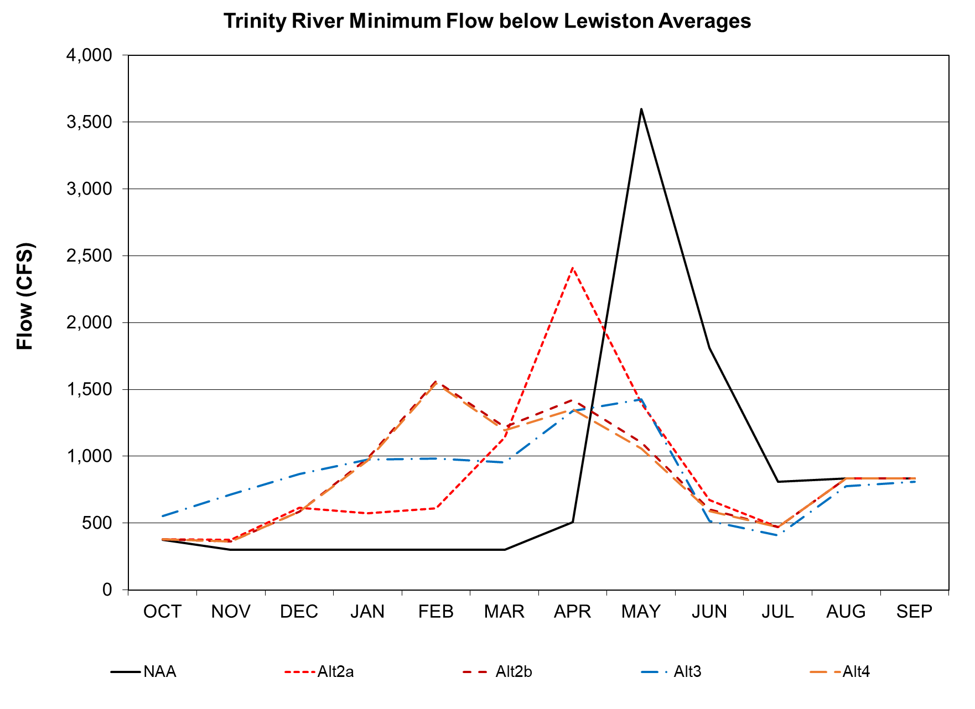
TRD Component – Lewiston Releases
NAA – 2000 Trinity ROD
Alternative 2 – higher flows in winter and early spring
Alternative 3 – seasonal oscillating hydrograph + pulse flows
Alternative 4 – same as Alt 2; reduced ROD volume by 15% in drought and low storage
Interim Update – Contents Subject to Change

Slide 32
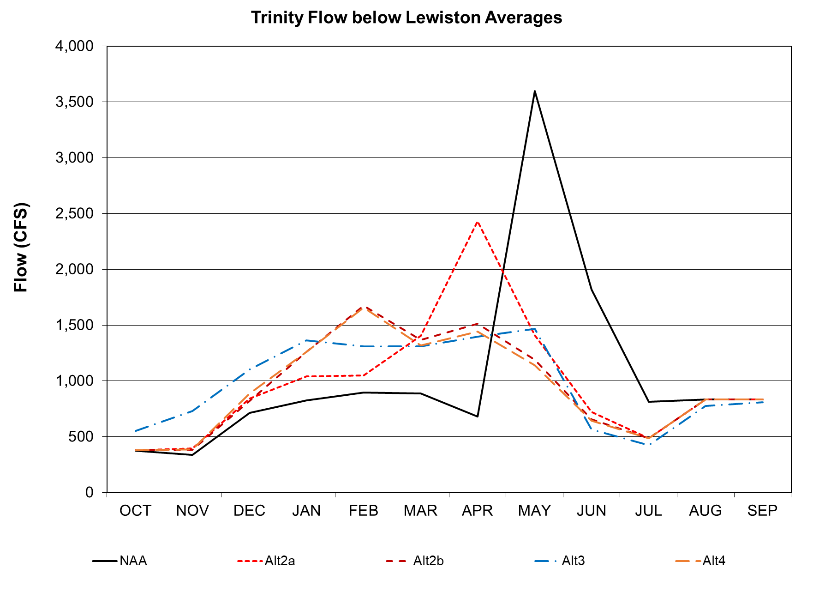
TRD Component – Lewiston Releases
Shift restoration releases earlier; reduce releases due to safety of dam concerns
Interim Update – Contents Subject to Change

Slide 33
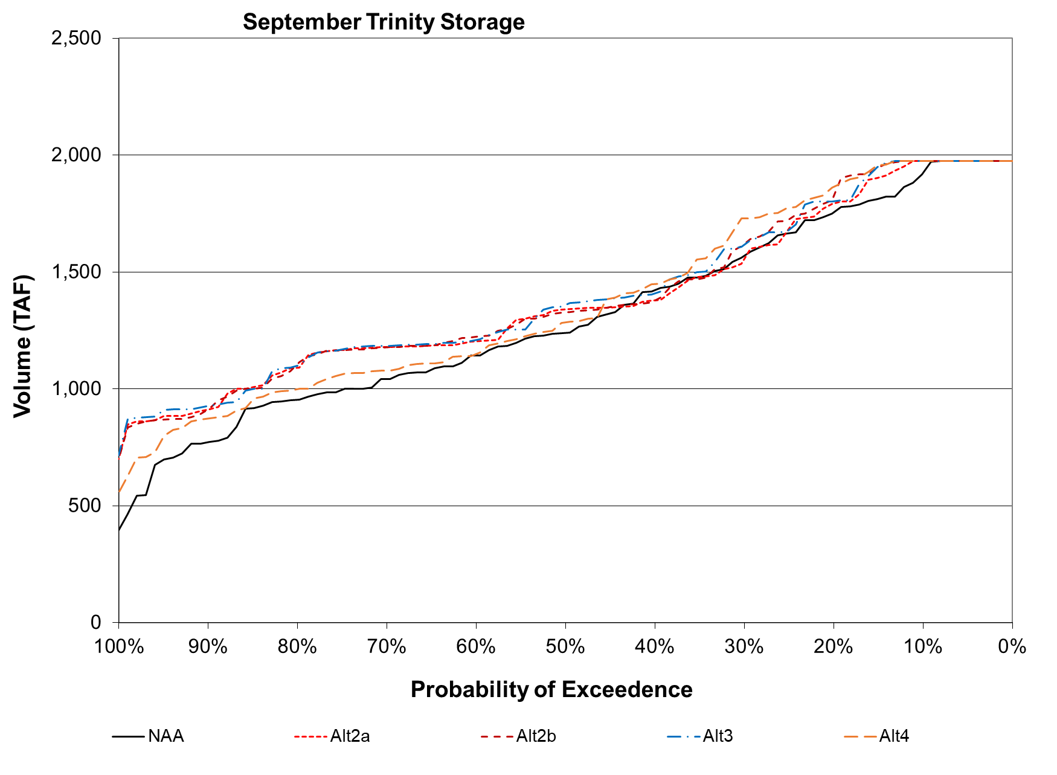
TRD Component – Storage
NAA – 2000 Trinity ROD
Alternative 2 – higher flows in winter and early spring
Alternative 3 – seasonal oscillating hydrograph + pulse flows
Alternative 4 – same as Alt 2; reduced ROD volume by 15% in drought and low storage
Interim Update – Contents Subject to Change

Slide 34
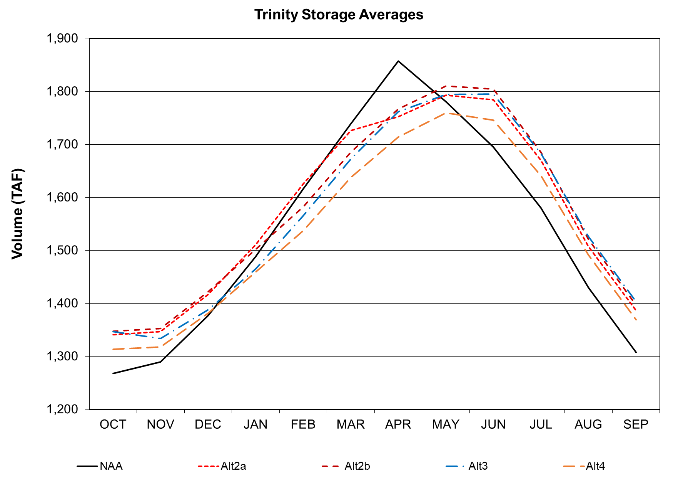
TRD Component – Storage
Peak storage shifts due to earlier restoration flows
Alternative have higher storage after May
Notes:
Graphics from Nov Joint Lead update
Key Takeaways

Slide 35
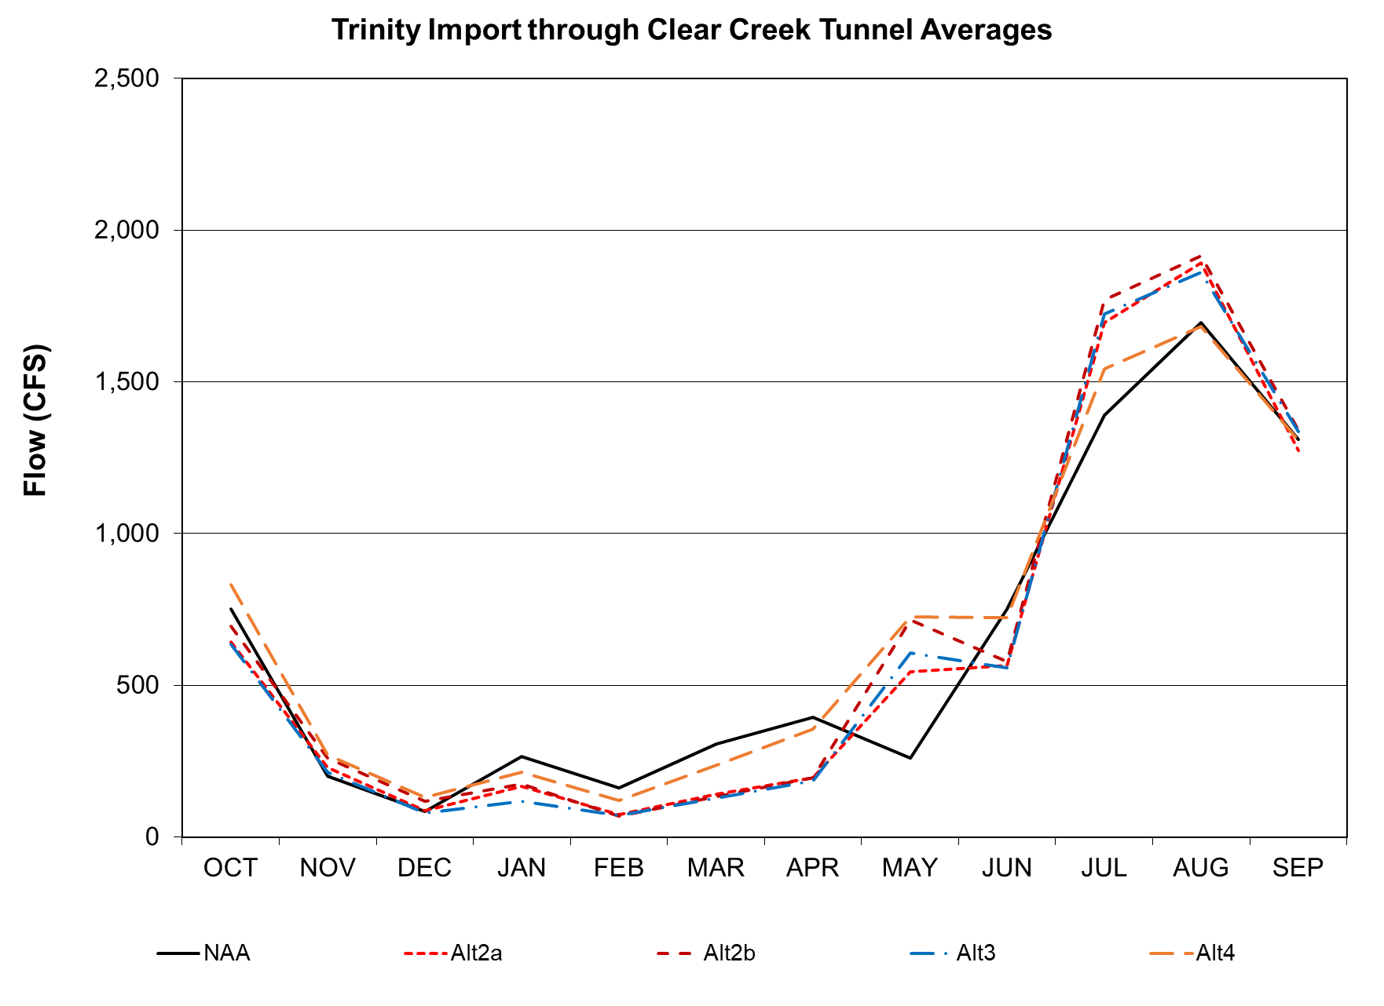
TRD Component – Diversions
NAA/Alternative 4 –
From Oct-Feb move warm water out of Lewiston and divert when SOD release is likely
From Mar-Sep Lower in spring/summer and higher in fall/winter for temperature benefits
Alternatives 2/3 –
From Oct to Jun/Jul 1st, prioritize Trinity River flow and temperature
From Jun/Jul 1st to Sep 30th, divert to meet other CVP needs
Notes:
Graphics from Nov Joint Lead update
Key Takeaways

Slide 36
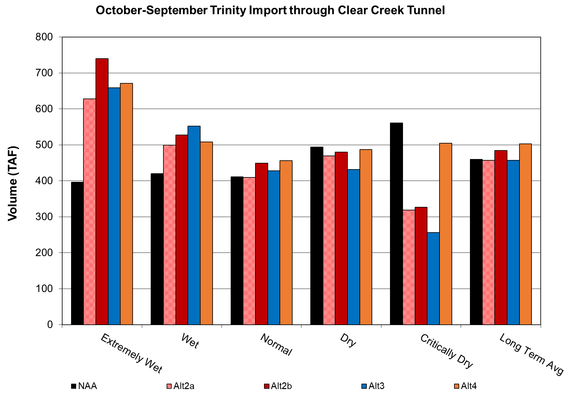
TRD Component – Diversions
Decrease in SOD releases can lead to higher diversions
Alt2&3 divert more in wetter years and less in dryer years
Notes:
Graphics from Nov Joint Lead update
Key Takeaways

Slide 37
TRD CalSim Modeling Next Steps
Integration with Sacramento River basin and QA/QC results for NAA and Alt 2 – 4
Continue work on modeling remaining Alternatives
Targeting early 2025 to complete CalSim modeling

Slide 38
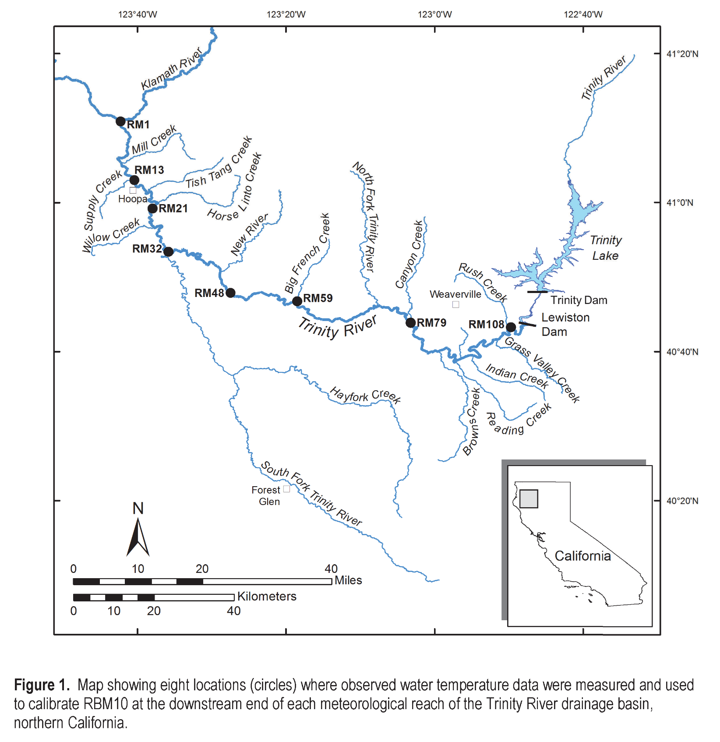
Trinity River Features for Temperature
Reservoirs
Trinity
Lewiston
Diversion
Clear Creek Tunnel to Whiskeytown Reservoir
Downstream tributaries
USGS, 2016

Slide 39
Modeling Workflow
DRAFT - Subject to Revision
Final Compliance Temperatures
Operations
Model
Release Target
Compliance Deviation
No
Yes
Yes
HEC5Q
Annual or Period of Record?
Converged?
Complete?
Lewiston Flows & Temperatures
RBM10
Compliance Temperatures
No

Slide 40
Temperature Logic
Many CalSim logics
Different period of record
Four temperature target logics
Similar locations with different mixes of timing and temperatures
Scenario | Douglas City | NF Trinity River
1 | July 15 – Sept 15 60F Sept 16 – Sept 30 56F Jan 1 – July 14 99F | Oct 1 – Dec 31 56F
2 | July 15 – Sept 15 60F Sept 16 – Sept 30 56F Jan 1 – Mar 31 99F | Oct 1 – Dec 31 56F Apr 1 – July 14 58.5 7DADA
3 | July 1 – Sept 14 60F Sept 15 – Sept 30 56F Jan 1 – June 30 99F | Oct 1 – Dec 31 56F
4 | Sept 15 – Sept 30 56F Jan 1 – Sept 14 99F | Oct 1 – Dec 31 56F
DRAFT - Subject to Revision

Slide 41
Temperature – Next Steps
Lewiston Warming Analysis
Parametric modeling of flow/release temperature
Domain extends only to Lewiston
Helps guide initial diversion rates
Climate Adjustments
Need to perturb historical climate to match CalSim scenarios
Adjusting air temperature, water temperature, and runoff volumes
Diversion Rate Refinement
Revision of initial diversion rates based on full temperature modeling

Slide 42
TRD Upcoming Coordination and Schedule
Planning to hold Interested Party meeting early next year
Winter 2024 | Early 2025 | Summer 2025 | Late 2025
Alternative Development | Modeling | Biological Assessment/Public Draft NEPA | Biological Opinion/Final NEPA/NEPA Decision
Notes:
Planning to hold Interested Party meeting early next year
Alternative Development – hoping to complete this winter
Modeling – targeting early 2025
BA/Public Draft NEPA document in the summer
And Bos and NEPA decision towards the end of next year

Slide 43
Thank you

